Slide 1
What Can HTML5 WebSocket
Do For You?
Sidda Eraiah
Director of Management Services
Kaazing Corporation

Slide 2
What is HTML5 WebSocket?
A full-duplex bidirectional communication channel in javascript
- over the internet
- over existing infrastructure
- yes, very much like a TCP connection
JavaScript API in all HTML5 complaint browsers

Slide 3
HTML5 WebSocket API
interface WebSocket {
  readonly attribute DOMString url;
  // ready state CONNECTING=0, OPEN=1; CLOSING=2; CLOSED=3;
  readonly attribute unsigned short readyState;
  readonly attribute unsigned long bufferedAmount;
  // networking
  attribute Function onopen;
  attribute Function onmessage;
  attribute Function onerror;
  attribute Function onclose;
  boolean send(in DOMString data);
  void close();
};
WebSocket implements EventTarget;

Slide 4
HTML5 WebSocket example
var ws = new WebSocket(“ws://game.example.com:12010/updates”);
ws.onopen = function () {
alert(“Connection open ...”);
}
ws.onclose = function () {
alert(“Connection closed.”);
}
ws.onmessage = function () {
alert( “Received Message: ” + evt.data);
}

Slide 5
What about Comet?
As mini-documents served by
  Comet
  Reverse Ajax
  Ajax Push
Based on HTTP 1.1 protocol
    half-duplex
Each request has HTTP header traffic
Does not scale

Slide 6
Why do you need it?
Ultra low latency data in your web client
  with very little overhead
  scalable applications
  low cost
Adiós Comet, Hola WebSocket!!!

Slide 7
Less Network Traffic
2 bytes overhead per WebSocket Frame
One TCP connection instead of establishing new TCP connection for each HTTP message (or mini-document)
Copyright © 2010, Kaazing Corporation,. All rights reserved.

Slide 8
See the difference in action
Ericsson Labs Video

Slide 9
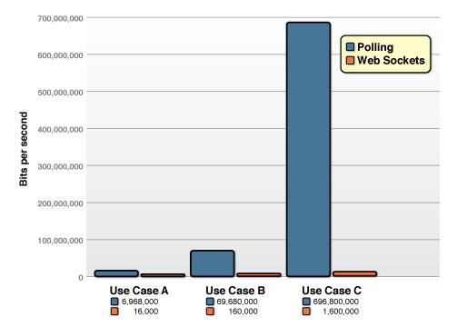
Polling vs. WebSocket

Slide 10
Overheard…
“Reducing kilobytes of data to 2 bytes…and reducing latency from 150ms to 50ms is far more than marginal. In fact, these two factors alone are enough to make WebSocket seriously interesting to Google.”
  —Ian Hickson (Google, HTML5 spec lead)
Copyright © 2010, Kaazing Corporation,. All rights reserved.
Notes:
150 ms (TCP round trip to set up the connection plus a packet for the message)
50 ms (just the packet for the message)

Slide 11
Apps with HTML5 WebSocket
Quake with HTML5 canvas and WebSockets
http://www.kaazing.me
Trading applications
Copyright © 2010, Kaazing Corporation,. All rights reserved.
Notes:
WebSocket is text-only

Slide 12
What else can you build?
Protocols based on HTML5 WebSocket
  XMPP and its extensions
  AMQP
  IRC
  STOMP
  Custom protocols

Slide 13
HTML5 WebSocket Browsers
Google Chrome
Safari (dev)
Opera (dev)
Coming soon to Firefox – Bug 472529

Slide 14
HTML5 WebSocket Summary
Disruptive technology
A full-duplex bidirectional communication channel from your browser to a server
- over the internet
- over existing infrastructure
- ultra low latency
- scalable
- extendable
- reduces your infrastructure costs

Slide 15
Kaazing WebSocket Server
Check out kaazing.com and kaazing.me
Provides HTML5 WebSocket API for Non-HTML5 browsers
    IE 6 & up
    Firefox 2 & up
    others
Provides HTML5 WebSocket API to
    Flex / Actionscript
    .NET & Silverlight
    Java FX & Java Web Start
We are hiring

Slide 16

HTML5 Book
Available now

Slide 17

HTML5 training
10% Off Any HTML5 Training
With Coupon Code WEB2EXPO
http://tech.kaazing.com/training/index.html

Slide 18
Q&A

Slide 19
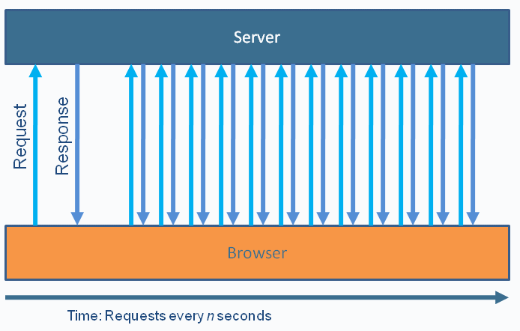
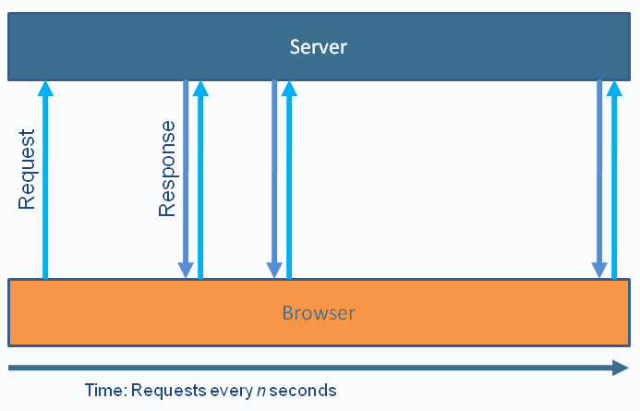
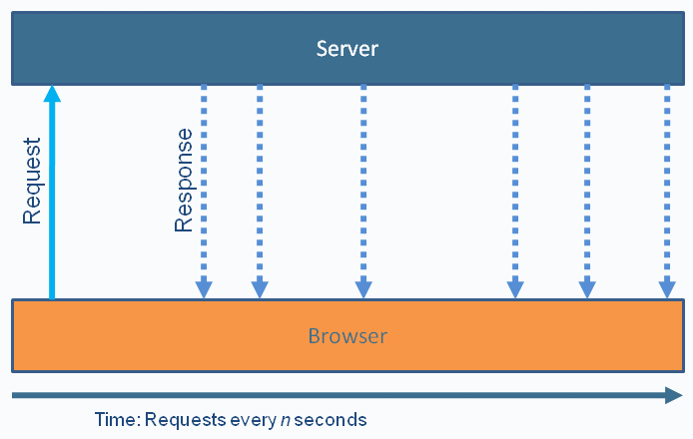
Polling, Long-Polling, Streaming
Polling
Long-Polling
Polling is resource intensive
Long-Polling degrades to polling during high message frequency
Streaming has issues through firewalls and proxies
Streaming

Slide 20


